Slide 1
Developing with the SharePoint Framework: Web Parts
Exploring a SharePoint Framework Project
Notes:
To view a recorded presentation of this deck:
https://www.youtube.com/watch?v=m1l_sgSwKek

Slide 2

Exploring a SharePoint Framework Project
Anatomy of a SharePoint Framework Project
Solution Lifecycle
Creating Client-Side Web Parts
Using the Office 365 CDN

Slide 3
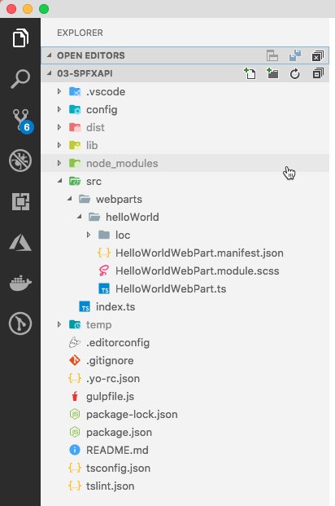
Project Structure
.vscode: includes Visual Studio Code integration files
config: includes all config files
dist: created automatically on builds – contains output from bundle process
lib: created automatically on builds – contains pre-bundled built files
node_modules: created automatically when installing all package dependencies with a package manager
src: this is the main folder of the project, it includes the web part, styles, and a test file
temp: created automatically on builds - contains local dev webserver files

Slide 4
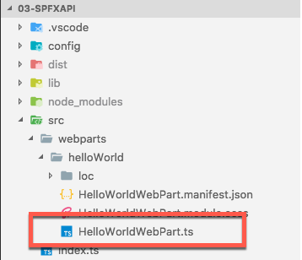
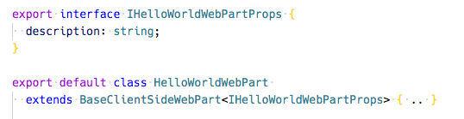
Key Files – web part class
Defines the main entry point for the web part
Extends the BaseClientSideWebPart
All client-side web parts must extend the BaseClientSideWebPart class in order to be defined as a valid web part
Notes:
BaseClientSideWebPart implements the minimal functionality that is required to build a web part. This class also provides many parameters to validate and access to read-only properties such as displayMode, web part properties, web part context, the web part instanceId, the web part domElement and much more.
Notice that the web part class is defined to accept a property type IHelloWorldWebPartProps.
The property type is defined as an interface:
export interface IHelloWorldWebPartProps { description: string; }

Slide 5

Key Files – web part properties class
Interface that defines the non-standard public properties on the web part
Persisted when the web part is saved / published from edit mode

Slide 6
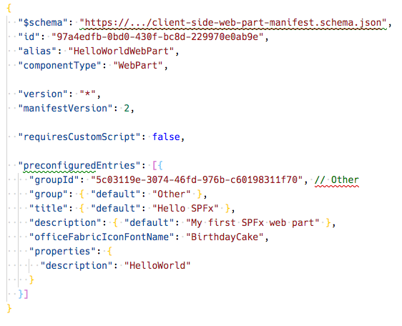
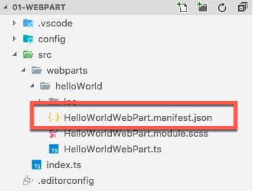
Key Files – web part manifest
Defines the web part metadata
Notes:
Defines the web part metadata such as version, id, componentType, manifestVersion, and description. Every web part must contain this manifest.

Slide 7
CSS Modules
https://github.com/css-modules/css-modules
All CSS classes are locally scoped
.helloWorld {} => .helloWorld_da83fer {}
SPFx’s build toolchain handles the complexities
Rules
*.module.scss - HelloWorldWebPart.module.scss
Use camelCasing; not kebab-casing
Reference classes in components as styles.helloWorldButton

Slide 8
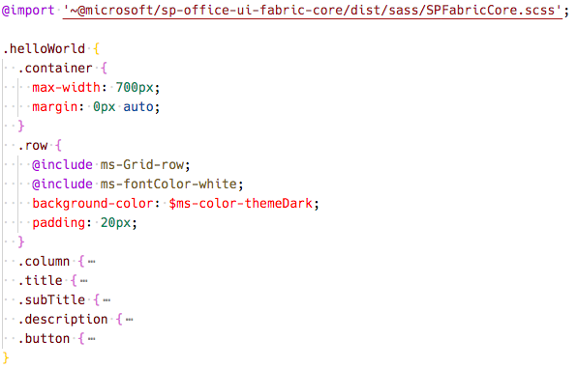
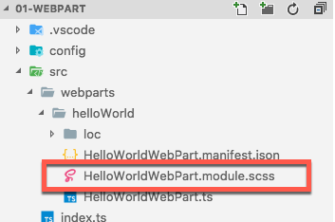
Key Files – SCSS file
Defines the web part styles
Notes:
When the project is built & compiled, the SharePoint Framework build process will do two things with this file.
First, it will compile the SCSS => CSS for use in the browser.
Then, it will generate two additional files.
One is a JavaScript file that exports a single object with the name/value properties will have the CSS module local unique names as the values for the class names that are the properties. The other file is a TypeScript declaration file that contains an interface of this file. Using these two files you can import them into your web part and reference the friendly class names rather than the generated CSS local module names.

Slide 9
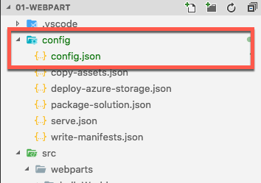
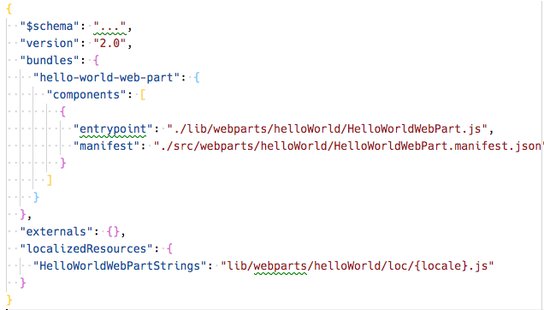
Key Files – config file
Contains information about your bundle(s), any external dependencies, localized resources
Specifies the script libraries used in the web part
Notes:
This file contains information about your bundle(s) and any external dependencies and localized resources.
- The entries section contains the default bundle information.
- The externals section contains the libraries that are not bundled with the default bundle.

Slide 10
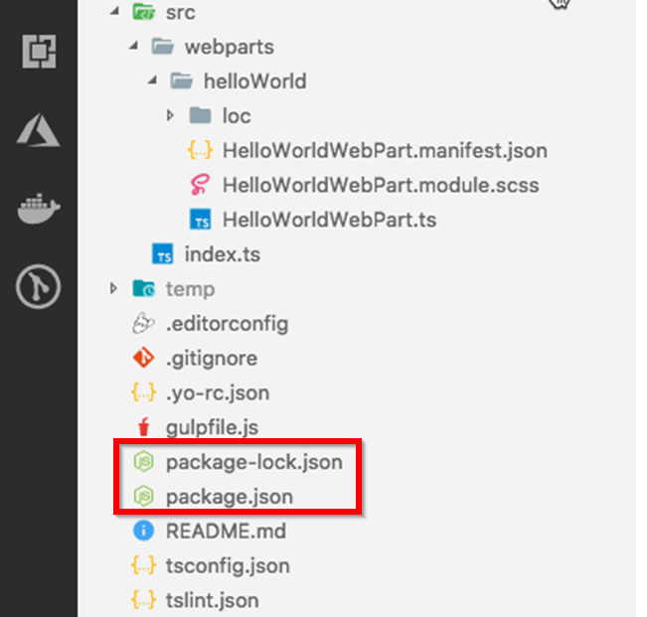
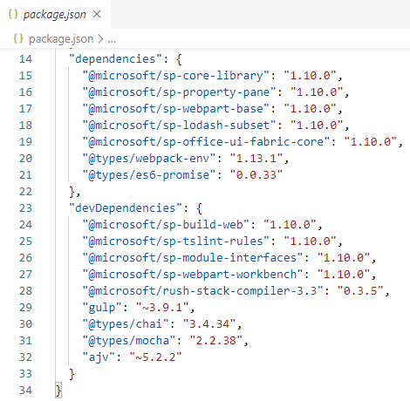
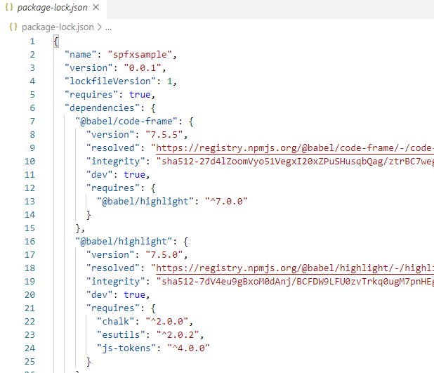
Key Files – package.json & package-lock.json
Contains the packages used by your solution
Use npm i to download the packages
Packages get stored in the node_modules subfolder
SharePoint Framework version
Only exactly 1.10.0
Only patch releases 5.2.x
Also minor releases 2.x.x
Notes:
Other important files to mention are package.json and package-lock.json, which go hand in hand. Pretty much every developed solution these days exists out of many reusable packages which on their turn can use many reusable packages. All of this gets together in these two files. The package.json file is where the packages you use in your solution will get registered. There’s a “dependencies” section and a “devdependencies” section. The first is where the packages go which are needed for your solution to work in production. The latter is where you can add packages which you only need during your development, such as code quality verifiers or tools to package things. By default if adding a package using npm i <package name> it will add it under “dependencies”. If you wish it to go to “devDependencies”, you should install it using npm i <package name> --save-dev. When you install a package, it will download all its contents and potential sub package contents into he node_modules subfolder under your solution folder. This folder typically gets huge. Especially if you want to share your code with someone else or store it in source control, it’s a recommended practice to not include the node_modules folder. Just copy or store everything else. On a new machine you can simply run npm i with no further arguments to have it download all the packages from the package.json file onto that machine again.
The package-lock.json was introduced since this entire tree structure of package dependencies turned out to be quite fragile. One seemingly minor update of one package in the entire tree could cause side effects to other packages causing side effects to packages that are using them etc. The only way to avoid this is to use the exact same version of every single package used in your solution. This is achieved by a package-lock.json file. It lists every single package used in the entire tree structure behind your application with the exact version number it was when you added it to your solution. This is the only way to play safe and not run into version issues.
The reason why that requires a special package-lock.json file is because the package.json file typically has a special syntax allowing for either patch (version number starts with ~) or minor (version number starts with ^) updates to be taken into account. This is indicated by the developer of the package itself if it should update to a later patch or minor version if one becomes available. In reality, as mentioned, this doesn’t always work well, therefore the package-lock.json was introduced which if present will always be used over your package.json file. Simply delete the package-lock.json file, run npm i in your solution folder again to make it obey the possible version differences. It will automatically create a new package-lock.json file again with the new versions being used.

Slide 11
Client-side Web Part Build Flow
npm install @Microsoft/generator-sharepoint -g
gulp serve
gulp bundle --ship
Install SharePoint Generator
Test
Package/Deploy
yo @microsoft/sharepoint
workbench
gulp package-solution --ship
Scaffold SharePoint Web Part Project
Local or Hosted
Package/Deploy
Code .
manual upload of the app
Build Web Part Code
UAT / Pre-production
Release using app catalog*
Ship?
Available on Classic and Modern Pages
Notes:
Demonstrate the typical process flow from beginning with a SharePoint Framework solution to deploying it to production

Slide 12
What the Gulp tasks do
clean: deletes temp folders created by build process (ie: dist, lib, temp)
build: build the project
default: equivalent to bundle
bundle: build, localize, and bundle the project
dev-deploy: deploy the current project to a development Azure CDN for sharing builds with colleagues
deploy-azure-storage: upload the assets to a Azure storage container
package-solution: package the project into a SPPKG
test: build, localize, and bundle the project and run tests, and verify the coverage
serve: build and bundle the project and run the development server
trust-dev-cert & untrust-dev-cert: trusts / untrusts the development SSL certificate in the local machine’s trusted root authority (self-hosted HTTPS site)
Notes:
This slide shows an overview of the default Gulp tasks included with the SharePoint Framework by Microsoft. You can run each of these from within your SPFx solution folder by running gulp <command> where command resembles one of the red marked keywords on this slide.

Slide 13
Solution Packaging
Gulp tasks package solutions
Package contents are put into an .sppkg file
JavaScript files, CSS and other assets are packageda long in the .sppkg file by default and copied to the Site Assets folder when deploying it to SharePoint
Ensure you enable Office 365 CDN for optimal performance
Set “includeClientSideAssets”: false in package-solution.json to not include assets in your .sppkg
> gulp package-solution
Notes:
The package-solution task uses a SharePoint Feature to package your web part. By default, the gulp task creates a feature for your web part.
You can view the raw package contents in the sharepoint folder.
The contents are then packaged into a .sppkg file. The package format is very similar to a SharePoint Add-in package and uses the Microsoft Open Packaging Conventions to package your solution.
If you don’t want the client side assets to be deployed along inside the .sppkg file going into the Site Assets library on SharePoint, set “includeClientSideAssets” to false in the package-solutoion.json file inside your SPFx project. You will then need to host the assets yourself manually somewhere else and serve them from there, i.e. Azure CDN. In most scenario’s you would want your files to be bundled along with the .sppkg file and served out of the Site Assets folder of SharePoint Online.
For more information, see:
https://docs.microsoft.com/en-us/sharepoint/dev/spfx/web-parts/get-started/serve-your-web-part-in-a-sharepoint-page

Slide 14
Office 365 CDN
Available for free with all Multi Tenancy Office 365 Tenants
Public CDN & Private CDN
Disabled by default
When enabled, will by default serve these files from the Office 365 CDN:
Public CDN
*/Masterpage
*/Style Library
*/ClientSideAssets
File extensions: CSS, EOT, GIF, ICO, JPEG, JPG, JS, MAP, PNG, SVG, TTF, WOFF
Private CDN
*/userphoto.aspx
*/siteassets
File extensions: GIF, ICO, JPEG, JPG, JS, PNG
Notes:
Only available to all Multi Tenant a.k.a. production a.k.a. worldwide Office 365 tenants which most of the customers will have. Not available to MT Enhanced, MT D-vNext, US Government, China and Germany cloud tenants.
Files hosted from the Office 365 CDN are much faster compared to when they’re being served from SharePoint Online itself. This is due to various factors such as the architecture of SharePoint storing content as BLOBs in databases and not all SharePoint farms yet making use of HTTP/2.
ClientSideAssets is where the assets of SPFx packages will get to deployed to when using includeClientSideAssets: true in your package-solution.json file, so they automatically get deployed to and served from the Office 365 CDN, no matter where in your tenant you deploy them to. This does require the public CDN to be enabled for your tenant.
For more information, see:
https://docs.microsoft.com/en-us/office365/enterprise/use-office-365-cdn-with-spo

Slide 15
Demo Enabling Office 365 CDN
Notes:
Use the commands listed in the article at https://docs.microsoft.com/en-us/office365/enterprise/use-office-365-cdn-with-spo to enable the Office 365 CDN on an Office 365 tenant such as the one deployed with your LOD environment. You’re free to choose whether to use the SharePoint Online Management Shell, Office 365 CLI or PnP PowerShell commands listed in the article to achieve this. Whichever fits your audience best or just ask them if they have a preference for either of them.
Demonstrate these commands (using PnP PowerShell in these samples):
Connect-PnPOnline -Url https://<tenant>.sharepoint.com -UseWebLogin
Get-PnPTenantCdnEnabled -CdnType Private
Get-PnPTenantCdnEnabled -CdnType Public
Set-PnPTenantCdnEnabled -CdnType Both -Enable $true
Get-PnPTenantCdnPolicies –CdnType Public
Get-PnPTenantCdnPolicies –CdnType Private
Get-PnPTenantCdnOrigin -CdnType Public
Get-PnPTenantCdnOrigin -CdnType Private

Slide 16

Summary
Anatomy of a SharePoint Framework Project
Solution Lifecycle
Creating Client-Side Web Parts
Using the Office 365 CDN

Slide 17
Developing with the SharePoint Framework: Web Parts
Testing the Web Part in the Local & Hosted Workbench

Slide 18
Exploring a SharePoint Framework Project
Local Workbench
Hosted Workbench
Different modes of the gulp serve task

Slide 19
Local Workbench vs. SharePoint Workbench
Local
Runs on https://localhost
Has no SharePoint Context
Developers can leverage mock data
SharePoint (Hosted)
Runs on a real SharePoint Site
https://<your-sharepoint-site>/_layouts/workbench.aspx
Has SharePoint Context
Uses SharePoint data

Slide 20
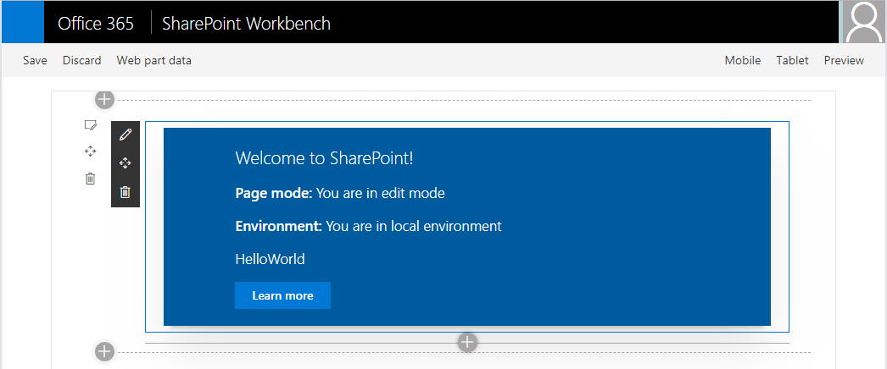
SharePoint Workbench
Local development time experience
Test your changes immediately even in offline mode

Slide 21
Debugging
Build and run on local server and automatically launch local SharePoint Workbench
Build and run solution on local server
> gulp serve
> gulp serve --nobrowser

Slide 22
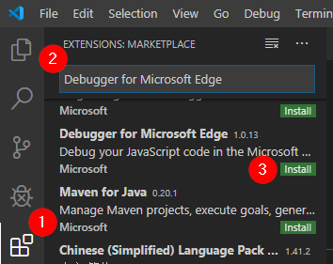
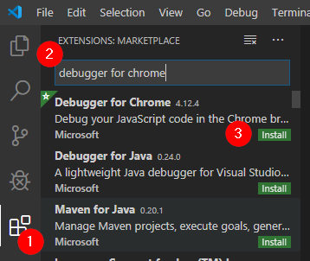
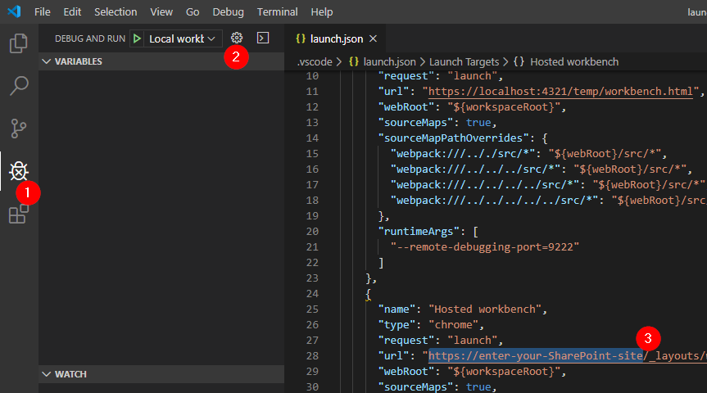
Debugging SPFx in Visual Studio Code
Add Debugger Extension for the browser you wish to use
Modify the launch.json file with your tenant
Run gulp serve --nobrowser
Choose Local or Hosted workbench
Hit F5 to start debugging
Notes:
If you wish to enable debugging of your SPFx solution from Visual Studio Code, you need to install an extension specific for the browser you want to use. For most of the well-known browsers an extension is available, i.e. Google Chrome, Microsoft Edge Chromium, Microsoft Edge edgeHTML and FireFox. You then need to modify the launch.json file with your tenant name. Manually start gulp serve --nobrowser and then hit F5 to launch the browser and attach the debugger. You can then set breakpoints in your TypeScript code which will be hit if the code executes.

Slide 23



Mapping Files Making Debugging Easier
SPFx web parts are authored in TypeScript
The build process transpiles the TypeScript into JavaScript, then bundles it all into a single file
As a result, it can be hard to debug the resulting JavaScript bundle
Source code mapping files make it possible to debug the original unbundled TypeScript code
Notes:
The mapping files automatically get generated by Visual Studio Code so you can set breakpoints in TypeScript, if you follow the steps on the previous slide, and have it hit the corresponding JavaScript line when it executes.

Slide 24
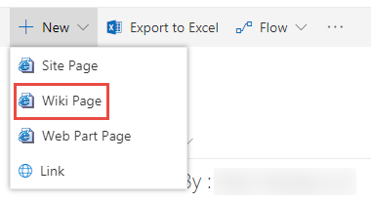
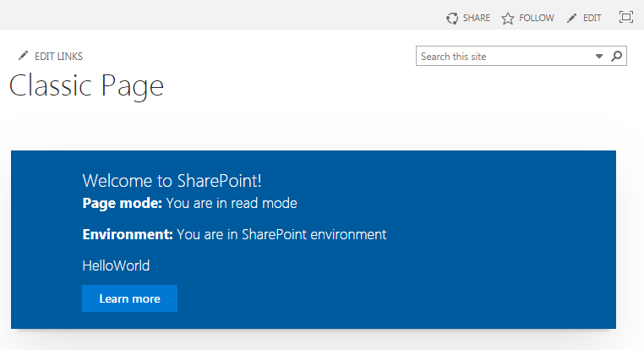
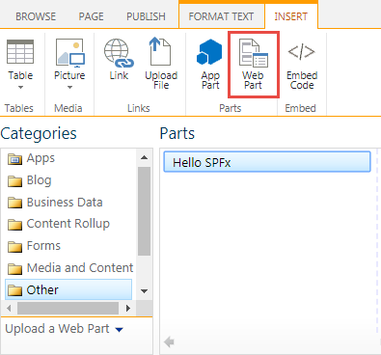
Classic Page
1
3
2
Notes:
SPFx WebParts can be added to a classic page as well.

Slide 25
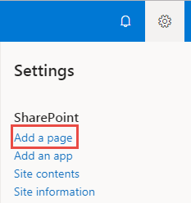
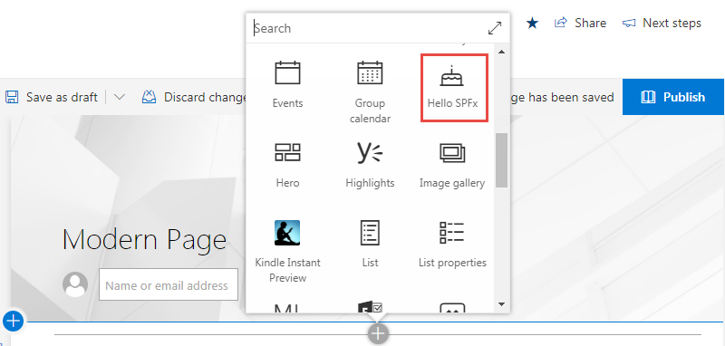
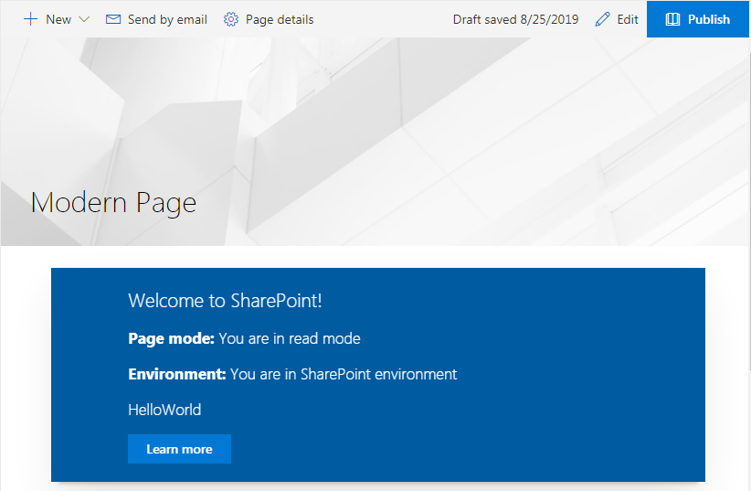
Modern Page
1
2
3
Notes:
And, of course, they can be added to modern pages, too. The modern experience will be discussed in more detail in a later module.

Slide 26
Demo Testing the Web Part in the Local & Hosted Workbench
Notes:
Open the “Hello World” SPFx solution you’ve generated in the previous lesson or just take any other SPFx solution in Visual Studio Code
Under View -> Terminal in Visual Studio Code, open the Powershell command line by going to the Terminal section
Run gulp serve to build the solution and launch the browser in the local workbench
Add the webpart and show that it works
Close the browser again and return to Visual Studio Code, leave gulp serve running in the terminal window inside Visual Studio Code
Click on the icon with the four squares in the bar at the left which brings you to the extensions
Search and install the extension called Debugger for Microsoft Edge (if using Edge Chromium or Edge edgeHTML) or Debugger for Chrome (if using Google Chrome)
Click on the bug icon in the bar at the left
At the top, next to “Local workbench”, click on the cogwheel which will open launch.json
In the section under “Hosted workbench”, replace the part “enter-your-SharePoint-site” with the URL to your Office 365 tenant, i.e. contoso.microsoft.com
At the top, next to “Debug and run”, switch the dropdown to “Hosted workbench”
Hit F5 to start your browser. It should open in the workbench hosted on SharePoint Online
Show how it serves the same SPFx solution you’re building locally, set a breakpoint if you wish and show how it gets hit when it executes that line of code

Slide 27
Summary
Local Workbench
Hosted Workbench
Different modes of the gulp serve task

Slide 28
Developing with the SharePoint Framework: Web Parts
Exploring the SharePoint Framework API

Slide 29
Exploring the SharePoint Framework API
Status Renderers
Loading & Error Indicators
Lodash
Page display modes
Page context
Environment type
Logging
SPComponentloader

Slide 30
SPFx Utilities
SPFx includes many utility libraries that make developing SPFx components easier for developers
To use the utilities
Import the appropriate utility library (if necessary)
Call methods in the libraries
Notes:
In the next slides we’ll go through some of these utilities

Slide 31
Status Renderers
Use when a web part is loading information from SharePoint or to display errors if a web part runs into issues that could prevent it from working properly
Available via the web part context property
Use the entire web part UX
Loading indicators
Useful when you are initializing or loading any content in your web part.
Error indicators
Used to display error messages.
Notes:
In the next slides we’ll show a sample of using these loading and error indicators

Slide 32
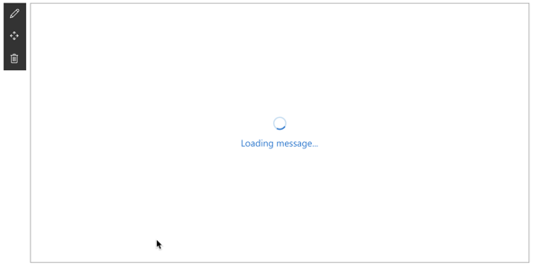
Loading Indicator
Display the loading indicator: displayLoadingIndicator()
Clear the loading indicator: clearLoadingIndicator()
this.context.statusRenderer.displayLoadingIndicator(this.domElement,"Loading message…"); this.context.statusRenderer.clearLoadingIndicator(this.domElement);

Slide 33
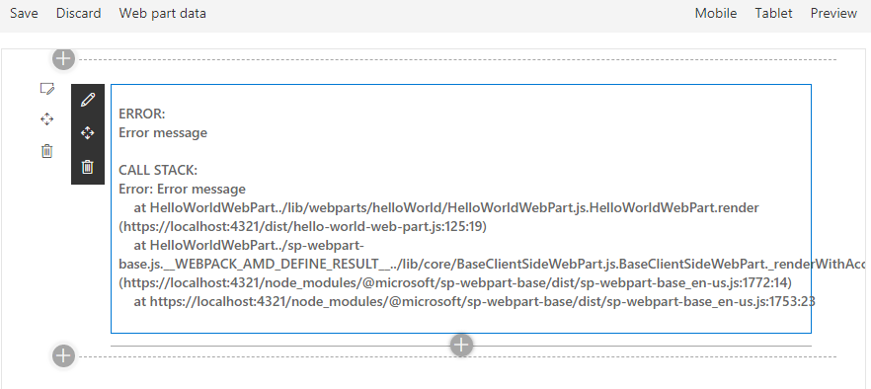
Error Indicator
Show an error, call renderError
Clear an error, call clearError
this.context.statusRenderer.renderError(this.domElement, err);
this.context.statusRenderer.clearError(this.domElement);

Slide 34
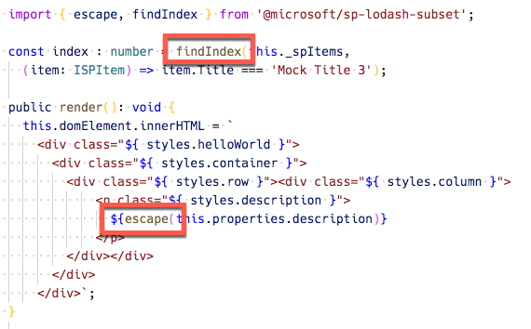
Lodash Utility Library
Use to perform operations on various objects like arrays, numbers, strings etc.
SharePoint Framework includes a subset of the lodash utility library:
https://lodash.com & https://www.npmjs.com/package/@microsoft/sp-lodash-subset
Notes:
Lodash is a great JavaScript utility library that you can use to perform operations on various objects like arrays, numbers, strings etc., SharePoint Framework includes the lodash utility library for use with SharePoint Framework out-of-the-box so you do not need to install it separately. To improve run-time performance, it only includes a subset of the most essential lodash functions.

Slide 35
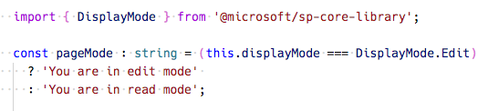
Page Display Modes
Classic Pages
Page and web part can be in different modes
Modern Pages
Page and web part are always in the same mode
Notes:
SharePoint pages have display modes which indicate in which mode that page and/or its contents (e.g. text and web parts) are displayed. In the classic server-side SharePoint page, the web page and the web part can be in different modes. For example, the web page can be in edit mode while the web part is not in edit mode. In the modern client-side SharePoint page, both the page and/or its contents are in the same mode.

Slide 36
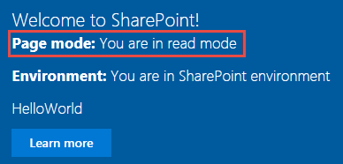
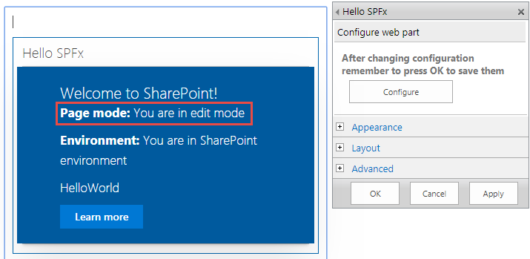
Page Display Modes – Classic Page
Page is not in Edit mode
Page is in Edit mode and the web part is in Edit mode
Page is in Edit mode and the web part is not in Edit mode

Slide 37
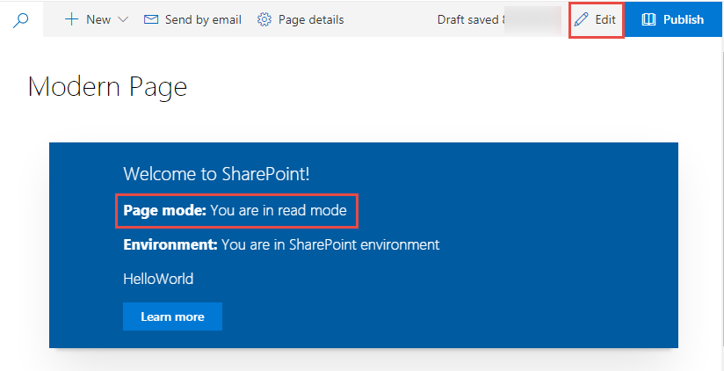
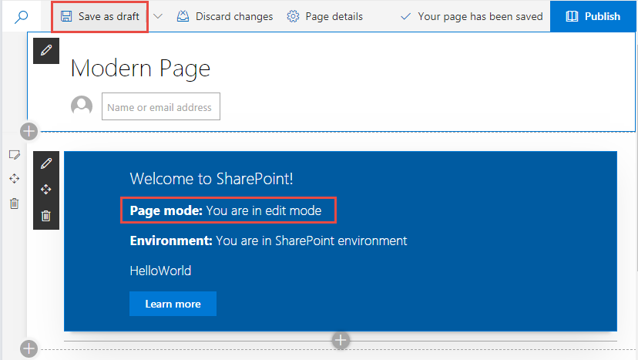
Page Display Modes – Modern Page

Slide 38
Page Context
Available with mock data in local Workbench
Fully available in SharePoint Workbench
Accessible Properties
Web title
Web absolute URL
Web server-relative URL
User login name
this.context.pageContext.web.title
Notes:
When the SharePoint workbench is hosted locally, you do not have the SharePoint page context. However, you can still test your web part in many different ways. For example, you can build the web part's UX and use mock data to simulate SharePoint interaction when you don't have the SharePoint context. However, when the workbench is hosted in SharePoint, you get access to the page context which provides various key properties, such as: - Web title - Web absolute URL - Web server-relative URL - User login name

Slide 39
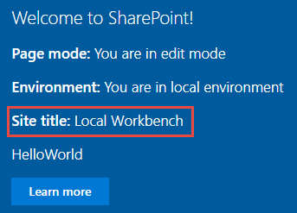
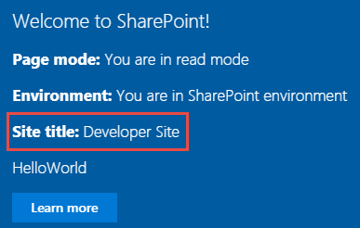
Page Context
Web part running in the local Workbench
Web part in the SharePoint Workbench, a modern, or a classic page

Slide 40
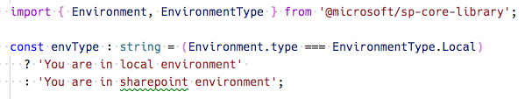
Environment Type
Use to determine where a web part is running
Local environment (aka: local workbench)
Real SharePoint environment (aka: hosted workbench)
Notes:
The SharePoint workbench gives you the flexibility to test web parts in your local environment and from a SharePoint site. The EnvironmentType module is used to determine which environment your web part is running in.

Slide 41
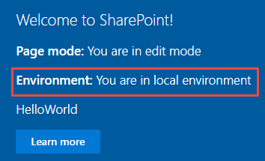
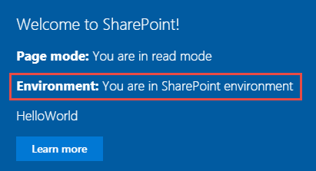
Environment Type
Web part running in the local Workbench
Web part running in the Workbench in SharePoint
Notes:
The SharePoint workbench gives you the flexibility to test web parts in your local environment and from a SharePoint site. The EnvironmentType module is used to determine which environment your web part is running in.

Slide 42
Logging
SPFx includes a built-in logging mechanism
All logging is output to the JavaScript console
Four static logging methods available
info : log information
warn : log warnings
error : log errors
verbose : log everything
The logging methods share the same signature
source: the source of the logging information (max 20 characters), such as the method or the class name
message: the actual message to log (max 100 characters)
scope: an optional service scope
The error method takes an Error object instead of a message string
Notes:
Logging is a very convenient and easy way to keep track of events happening in the web part, instead of having breakpoints, or alerts in JavaScript. The SharePoint Framework has a built-in logging mechanism.
Note: The Log class contains four static methods for logging:
info : log information
warn : log warnings
error : log errors
verbose : log everything
In the SharePoint Framework all logging is done to the JavaScript console and you can see the logging using the developer tools in a web browser.
All static methods have the same signature, except the error method - they take three arguments:
source: the source of the logging information (max 20 characters), such as the method or the class name
message: the actual message to log (max 100 characters)
scope: an optional service scope
The error method takes an Error object instead of the message string, otherwise they are the same.
For more information, see:
https://github.com/SharePoint/sp-dev-docs/wiki/Working-with-the-Logging-API

Slide 43
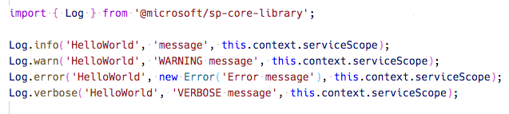
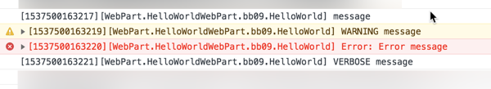
Logging
Notes:
This shows what the TypeScript would look like to add something to the log and at the bottom how it would be displayed in the browser developer console which can be seen by hitting F12 in your browser (i.e. Edge, Internet Explorer, Google Chrome, FireFox, etc.)

Slide 44
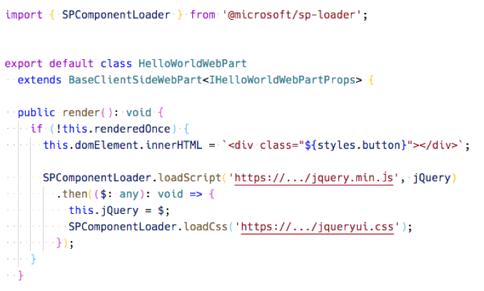
Loading scripts using SPComponentLoader
Notes:
Notice how the SPComponentLoader is wrapped in the if (!this.renderedOnce) clause. The render function of Client-Side Web Parts is called initially whenever a web part is added to the page, but also every time a web part property is changed in the Property Pane. Because we only want to load the scripts with the SPComponentLoader one time, we use the renderedOnce property to verify that the Web Part is rendering initially and then load the required modules.
When loading jQuery using the SPComponentLoader we load it as a global script associated with the jQuery variable. Also, as we're loading the Simple Weather jQuery plugin we need the global variable which the plugin is using to add itself to jQuery. Because the plugin is not an AMD module, the jQuery variable must be available in the global scope.
Also note, that after loading jQuery and before loading the Simple Weather plugin, we store the reference to jQuery in the this.jQuery variable. We we will need it in our custom renderContents function to instantiate the Simple Weather plugin in the Web Part.

Slide 45
Demo Exploring the SharePoint Framework API
Notes:
Demo steps at:
https://github.com/SharePoint/sp-dev-training-spfx-web-parts/tree/master/Demos/03-spfxapi

Slide 46
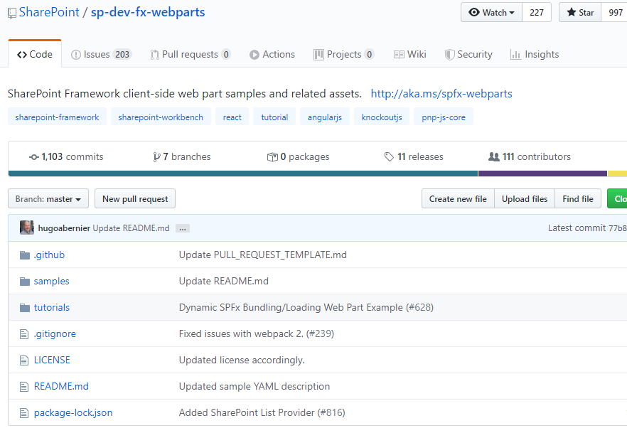
SPFx Samples
Lot’s of good samples are available in GitHub
Don’t reinvent the wheel
https://github.com/SharePoint/sp-dev-fx-webparts

Slide 47
Summary
Status Renderers
Loading & Error Indicators
Lodash
Page display modes
Page context
Environment type
Logging
SPComponentloader

Slide 48
Reading further
SharePoint Framework
https://docs.microsoft.com/en-us/sharepoint/dev/spfx/sharepoint-framework-overview
Overview of SharePoint client-side web parts
https://docs.microsoft.com/sharepoint/dev/spfx/web-parts/overview-client-side-web-parts

Slide 49
Reading further
Debugging SharePoint Framework solutions in Visual Studio Code
https://docs.microsoft.com/sharepoint/dev/spfx/debug-in-vscode
Debug SharePoint Framework solutions on modern SharePoint pages
https://docs.microsoft.com/sharepoint/dev/spfx/debug-modern-pages
Use the developer dashboard
https://docs.microsoft.com/sharepoint/dev/spfx/use-developer-dashboard

Slide 50
Lab In this lab you work with the SharePoint Framework to create a client-side web part and leverage different parts of the SharePoint Framework API. aka.ms/spdevwsM4L2
Notes:
Lab manual at:
https://aka.ms/spdevwsm4l2

